Slide 1
Friday, September 9, 2016
Write In Your Agenda:
Write In Your Monitoring Log:
CW:
Puzzling Pangaea.
HW:
Have Monitoring Log signed.
Response to Warm-Up:
Tell two facts you know about Pangaea. If you know NOTHING, explain how you think the moving lithosphere has changed the earth's appearance over time
You will need:
Pencil
Hand in Earth’s Landscape webquest.

Slide 2
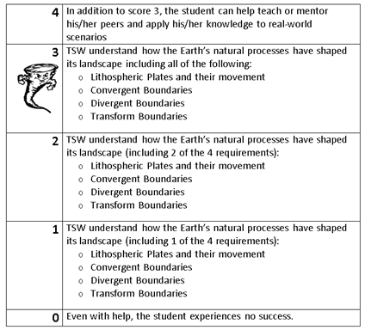
Learning Goal and Scale
TSW understand how the Earth’s natural processes have shaped its landscape (including Lithospheric Plates and their movement, Convergent, Divergent, and Transform boundary landforms).

